Slide 1
SLIP OR TRIP
Was Mr. Volupides' Death an Accident? Let's Look At the Evidence.

Slide 2
SLIP OR TRIP
GET YOUR GRAPHIC ORGANIZER READY
Was Mr. Volupides' Death an Accident? Let's Look At the Evidence.

Slide 3
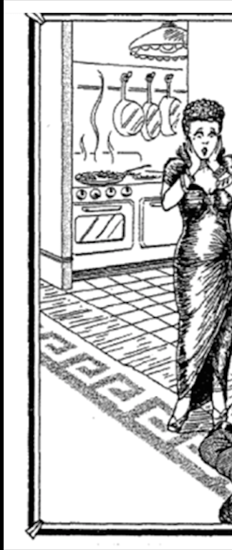

Slide 4
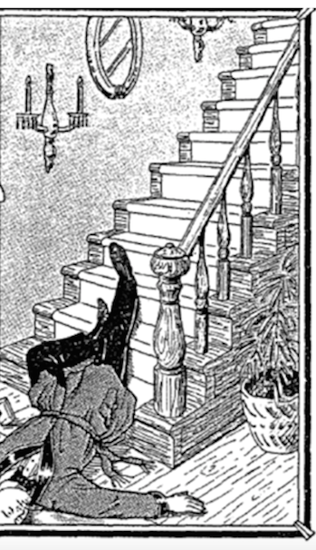

Slide 5
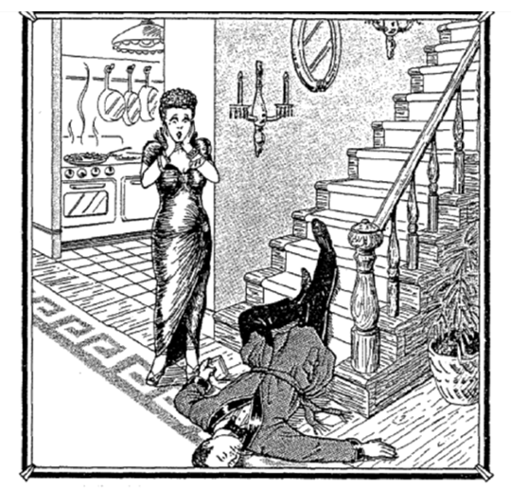

Slide 6
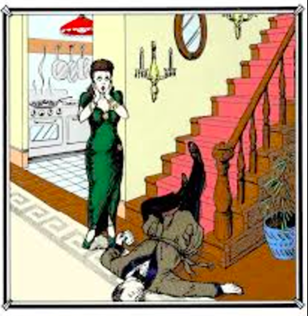

Slide 7
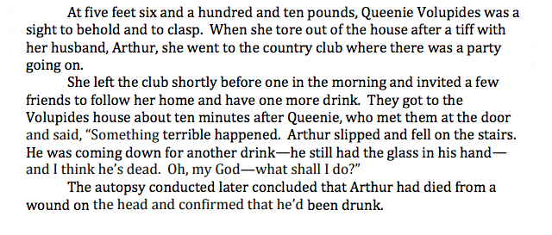

Slide 8
Philosophical Chairs

Slide 9
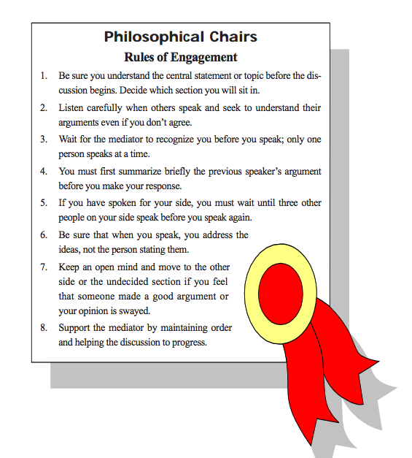

Slide 10
As a rule, in general, ...

Slide 11
RAFT
Role of the Writer: Who are you as the writer?
A movie star? The President? A plant?
Audience: To whom are you writing?
A senator? Yourself? A company?
Format: In what format are you writing?
A diary entry? A newspaper? A love letter?
Topic: What are you writing about?

Slide 12
You are a police officer who has received an anonymous tip from a neighbor who has noticed people coming and going at different times from the Volupides mansion.

Slide 13
Police Report
Should Include:
Arrival Time
What was discovered (found)
What Queenie said
What the autopsy found
Whether the evidence supports what Queenie said
Conclusion and/or Recommendations
Explanation of evidence supporting your conclusion and recommendations
Arthur Volupides; Queenie Volupides

