Slide 1
Two Voice Poems`
EQ: How can I express myself through poetry...Do I Dare?

Slide 3
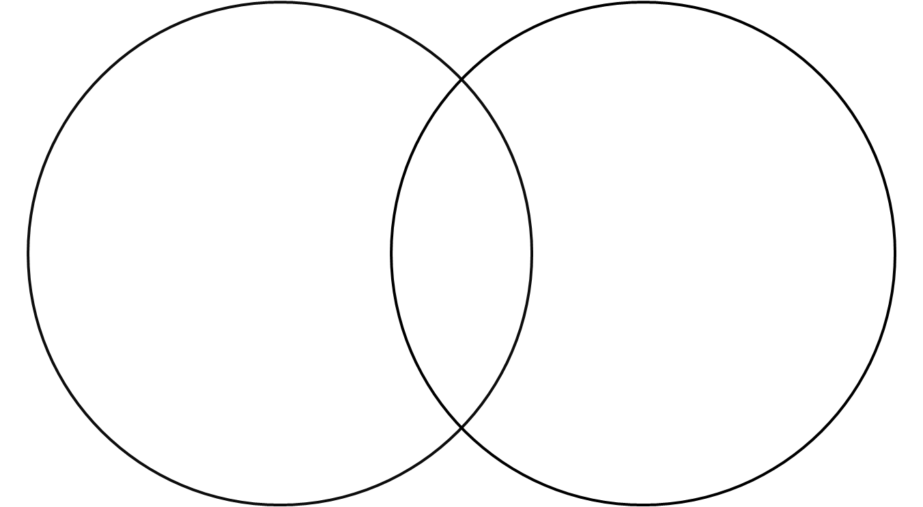
With your Venn Diagram, Compare and Contrast what you have in common and different with your partner

Slide 4
Teacher vs. Student
I am a teacher
I am a student
Seven years my trade
Eight classrooms
Fourteen classrooms
Nine hundred children
Fourteen teachers
Have touched my life. Have touched my life.
Every day I come Every day I come
My choice, my call

Slide 5
They make me
I'm glad I'm here I'm glad I'm here.
I come to teach
I come to learn
I come to earn a paycheck I come to earn my grades
I come to be with I come to be with
my friends my friends
I work very hard
They make me work hard
Lesson plans, forms and
more forms
Projects, exams, oral reports
I have to correct I have to write
so many papers so many papers When do I have time When do I have time
for my personal life? for my personal life?

Slide 6
I HATE I HATE
HOMEWORK! HOMEWORK!
I love my students
My teachers hate me
Sometimes I think
the kids hate me
Most of my teachers
are pretty cool
Sometimes they Sometimes they
make me so mad make me so mad
Like when it's only
been ten minutes
since lunch and they
ask to go to the restroom
and I know it's because
they are really worried
about how their hair
looks...

Slide 7
Well, they won't let us talk I write about what's important to me!
or when they won't
talk (silence)
or when they won't
stop talking
It's like they don't think we have a life and we should just be able to stop it when the bell rings and start talking about what they want us to talk about instead of what is important to us.
(glare)
They can make me laugh I like to play I like to joke and put people on They help me stay young New music New slang

Slide 8
"I love school.....not!"
I try to challenge them
They challenge me
Challenge their
perceptions of the
world and themselves
I challenge them back
I try to keep them I try to keep them
on their toes on their toes
Sometimes I'm so
proud of them
Sometimes I get good grades
They work hard I work hard on something
They rise to my challenge
They succeed I succeed
I feel so proud I feel so proud
All nine hundred

Slide 9
have moved on
It's time to move on
I worry about them
when they go
It's kind of scary
I hope I've provided
them each with
little something that
will make the way a
little smoother
And exciting
And I am often reassured
as I grow to know my

Slide 10
students each year
because always
I find something uniquely
wonderful and special
in each one
This gives me hope
Because Because
They are the future I am the future.

Slide 11
Poems with Two Voices
Offers two perspectives or opposing points of view
A dialogue
Each voice speaks individually and then the two voices speak together.
When speaking together, the voices comment on something they agree or agree to disagree about.
In the end the two sides do not have to agree. They may agree to disagree.

Slide 12
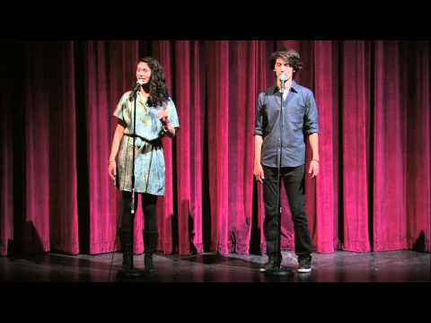

Slide 13
Another Example:
We are Triangles
I am a right triangle
My sides aren’t equal
I am an Isosceles triangle
I have two equal sides
Both of us are polygons
I have one right angle
I have two angles of
the same measure
We both equal 180 degrees
My acute angles are complementary
All of my angles are acute
We both have three sides
I am a right triangle
I am an Isosceles triangle
We are Triangles

Slide 14
Now, it’s your turn!
Using the Venn diagram and any other information you might generate, create a dialogue poem about you and your partner.
If you want to be creative, establish a “persona” for each of you.

Slide 15
Two Voice Poems
Get your Venn Diagram, materials and your partner from yesterday.
Prepare to complete your 2 Voice Poem!

Slide 16
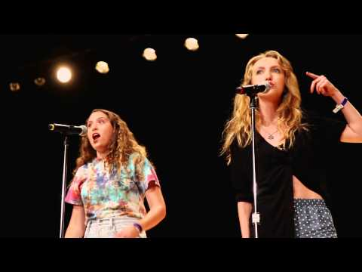
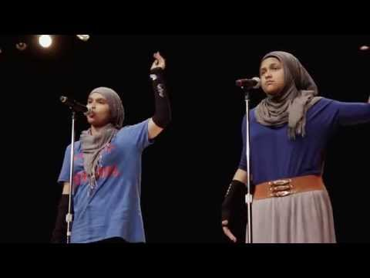
Your Task:
You and your partner will use your Venn Diagram and create a Two Voice Poem
Each Poem must have:
At least 10 lines for each speaker (individual)
At least 6 combined speaking lines
Likes and Differences must be displayed
Your Final Draft will be placed on White paper.

Slide 17
Your Task :
TURN IN SYLLABUS AGREEMENT, forms and classroom donations.
Complete your Rough Draft (10 to 15 mins)
Work on your final draft paper (10 to 15 mins)
Get ready to present!

Slide 18
Presentations

