Slide 1
Making Inferences
Notes:
‹#›

Slide 2
Inference
Take what you know and make a guess!
Draw personal meaning from text (words) or pictures.
You use clues to come to your own conclusion.
Notes:
‹#›

Slide 3
Schema
Your schema is what you already know about a topic
Think about a schema as a file folder in your mind

Slide 4
Activating Your Schema
When you start to read a text, you need to open up the file folder about the topic
This is called “activating your schema”
Notes:
‹#›

Slide 5
Make an Inference!
What does this image tell me?
Notes:
‹#›

Slide 6
Question…
What did I already know that helped me make that inference?
Did I use picture or written clues?
Notes:
‹#›

Slide 7
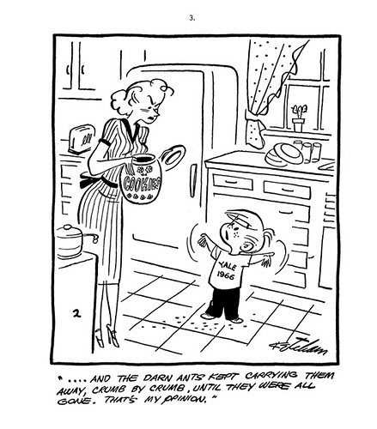
Help Me Make an Inference!
Notes:
‹#›

Slide 8
More Questions…
Did you use words, graphs, or picture clues to help you make a guess about what that cartoon meant?
Notes:
‹#›

Slide 9
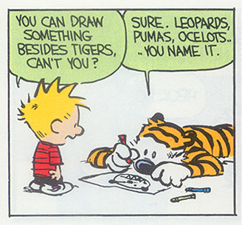
Try Again!
Can he draw more
than tigers?
Look up words you
don’t know!
Notes:
‹#›

Slide 10
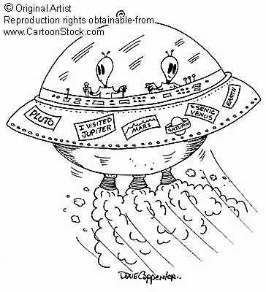
Make 1 more Inference
Notes:
‹#›

Slide 11
How Do Good Readers Make Inferences?
They use:
Word/text clues
Picture clues
Define unknown words
Look for emotion (feelings)
Use what they already know
Look for explanations for events
ASK themselves questions!
Notes:
‹#›

Slide 12
Make Another Inference
Miss White has recess duty. Jacob finds a frog, picks it up, and runs over to show it to Miss White. Miss White screams, jumps, and runs as fast as she can into the school.
What can you infer from this passage?
What are the “clues” in this passage?

Slide 13
Authors vs. Readers
Authors Imply, Readers Infer.
Authors make implications that readers have to infer.
What do I mean by these statements?
Good Readers are Detectives who are always looking out for clues to help them better understand stories and pictures.
Notes:
‹#›

Slide 14
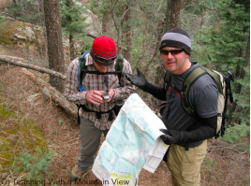

Slide 15
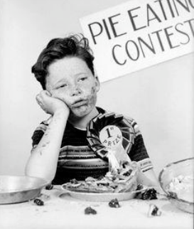

Slide 16
